Slide 1
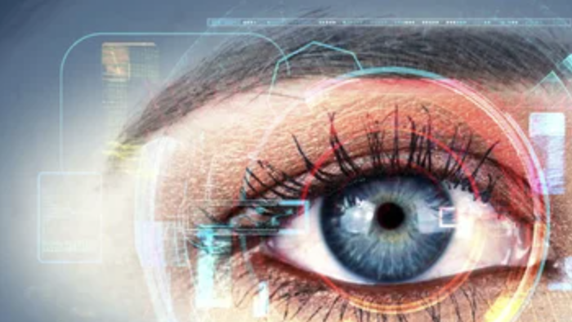
What our eyes can tell us
Google’s AI can see through our eyes what our doctors can’t

Slide 2
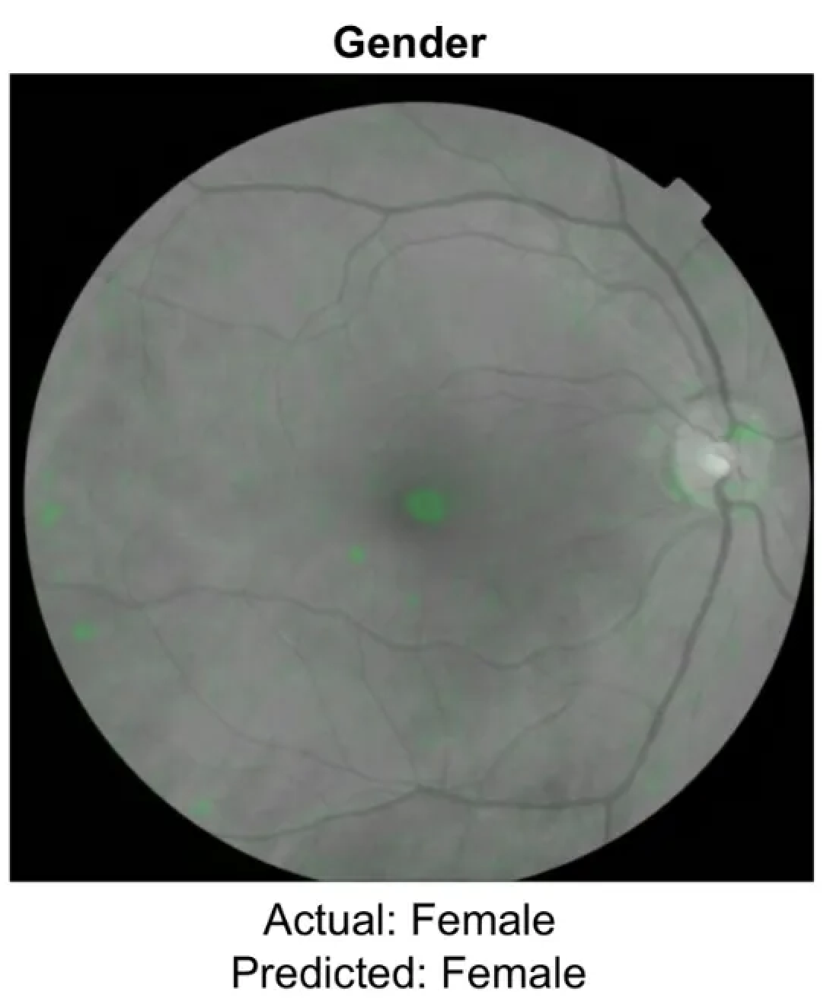
What do you see?
Notes:
What does this image tell you? To me, it says ‘that’s an eye’; for doctors, it’s says ‘indeed, it’s a retinal photo’. But for Google’s AI, it says that this eye is from a DFAB patient.

Slide 3
This AI connected patterns to distinguish gender AaB, with an AUC of 0.97
Detects more True positives and negatives
Notes:
This AI has somehow connected patterns that are too subtle to the human eye, trained to expertise or not, to distinguish gender assigned at birth.
Now why do I say it like that? Because this is something that doctors can only guess at - the AI has an AUC (Area under the ROC Curve) of 0.97 - means the classifier can detect more numbers of True positives and True negatives.

Slide 4
How does it work?
Convolutional neural network, optimised for image classification.
Deep Learning (ML) for training.
Diseased vs healthy eye comparison
Model “looks” at generally random areas of the eye.
Attention maps (saliency or heat maps) were generated to represent what it was looking at, and 100 random samples were presented to ophthalmologists.
It was looking at a bit of everything, but nothing specifically at all.
Notes:
This AI uses convolutional neural network. It’s a specific type of neural network optimised for image classification, the same technique that Google uses to label millions of Web images. Deep Learning, a machine learning technique that uses neural networks to model very complex functions, is their way to train it.
The model “looks at” generally random areas in the eye that help it make a most accurate gender prediction.
What does it look at? Just about everything, and nothing at all.
100 heat maps (like the one we saw at the beginning) were randomly selected and interpreted by professionals - and they found that areas like the vessels and optic disc were most highlighted with over 70% of cases, and around 50% non-specific areas.
So it was looking at what doctors thought was random, but these helped the AI be as accurate as possible.

Slide 5
Comes from major collab with US and India experts & hospitals, with initial purpose of aiding Diabetic Retinopathy diagnosis.
Ophthalmologists review and prediction from the algorithm for debate and decision on final diagnosis.
July 2018 results
Training dataset of 128K images
2 validation sets:
random sample of almost 10K images
public dataset of 1.7K images
The model worked insanely well!
96–97% sensitivity and 93% specificity, helping them get as few false negatives as they could.
Notes:
Now this stems from a major model collaboration between US and India experts and hospitals, which was reviewed from 2018 up until this year for the initial purpose of aiding in Diabetic Retinopathy diagnosis.
Between ophthalmologists review and prediction from the algorithm, it was debated and decided on final diagnosis.
On July 2018 results were published with a training dataset of 128K images, and 2 validation sets: 1) A random sample of 9963 images not overlapping with the previous training set. 2) A publicly available data set with 1748 images.
The model worked insanely well. It had a 96–97% sensitivity and 93% specificity, helping them get as few false negatives as they could.

Slide 6
What’s the use of this?
Nothing, right now.
Notes:
What’s the use of this? Right now, nothing. It’s not directly useful nor faster than reading your patient’s chart, but it doesn’t mean that this is useless information.

Slide 7
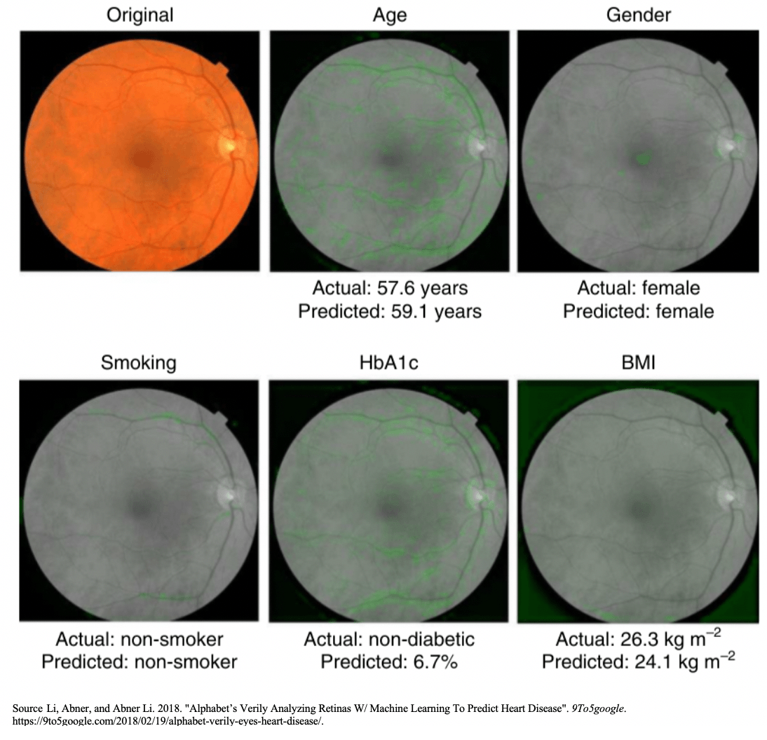
Opens doors for anatomy research
More personalised and efficient approach to diagnosis
Notes:
it opens doors to our eyes’ anatomy that this branch in medicine did not think possible. The same way that stroke symptoms are presented differently by gender, investigating anatomy differences could help in a more personalised and efficient approach in diagnosis, making sure that we’re not leaving the human factor behind.

Slide 8
Thank you
Notes:
Sources:
Google’s AI can see through your eyes what doctors can’t
Deep Learning in Ophthalmology —How Google Did It
Lessons learned from translating AI from development to deployment in healthcare
Google’s AI to Revolutionize Healthcare: Eye Scan to Predict Heart Disease and more

